Slide 1
Data Structure-Graph
Submitted by sigma warriors

Slide 2
Graph- Introduction
Non-linear data structure consisting of vertices and edges.
Consists of a set of nodes and a set of edges that connect pairs of nodes.
Represent the relationships or connections between these entities.
Used to model a wide range of real-world scenarios, including social networks, transportation networks etc.

Slide 3
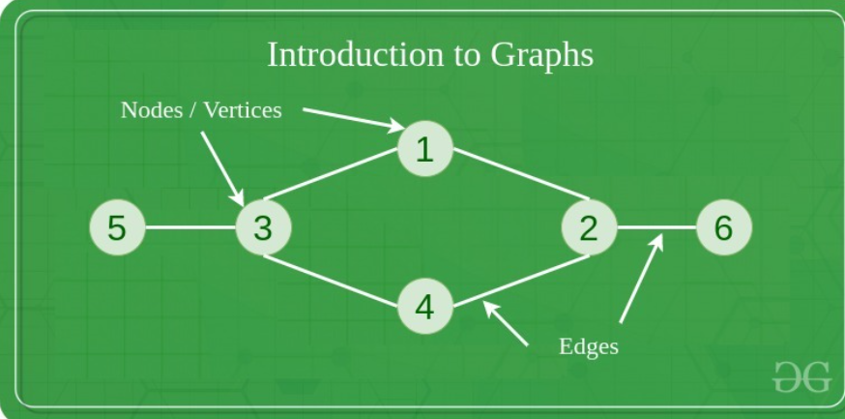
Components of a Graph
Vertices: Vertices are the fundamental units of the graph. Sometimes, vertices are also known as vertex or nodes. Every node/vertex can be labeled or unlabelled.
Edges: Edges are used to connect two nodes of the graph. It can be ordered pair of nodes in a directed graph.Sometimes, edges are also known as arcs. Every edge can be labelled/unlabelled.

Slide 4
Graph – Significance
Representation of Relationships
Problem solving
Data Analysis
Modeling Complex Systems
Visualization
Communication and Collaboration

Slide 5
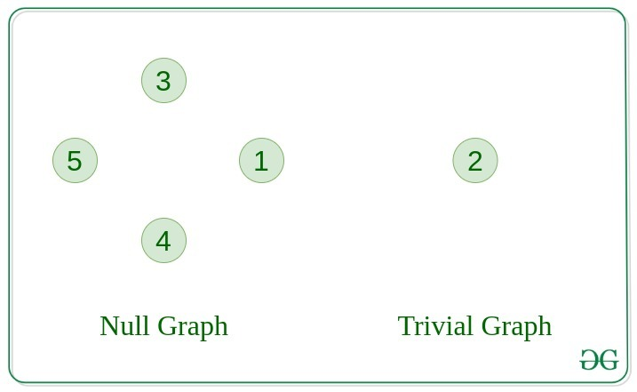
Graph–Types
Main types of graphs are:
1. Null Graph
A graph is known as a null graph if there are no edges in the graph.
2. Trivial Graph
Graph having only a single vertex, it is also the smallest graph possible

Slide 6
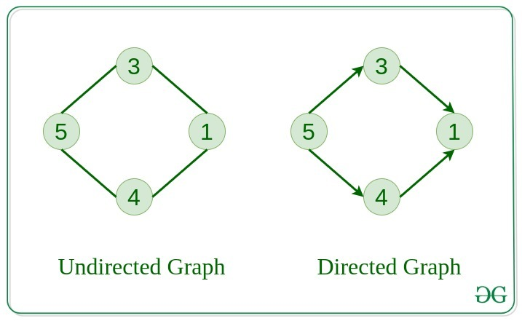
Graph–Types(Cont)
3. Undirected Graph
A graph in which edges do not have any direction. That is the nodes are unordered pairs in the definition of every edge.
4. Directed Graph
A graph in which edge has direction. That is the nodes are ordered pairs in the definition of every edge.

Slide 7
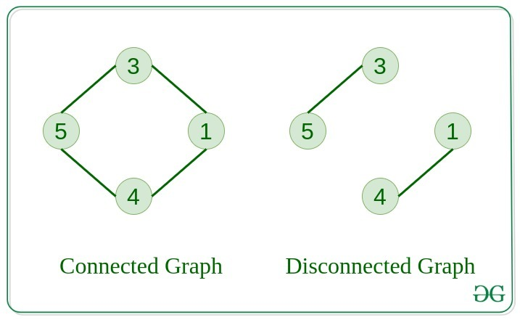
Graph–Types(Cont)
5. Connected Graph
The graph in which from one node we can visit any other node in the graph is known as a connected graph.
6. Disconnected Graph
The graph in which at least one node is not reachable from a node is known as a disconnected graph.

Slide 8
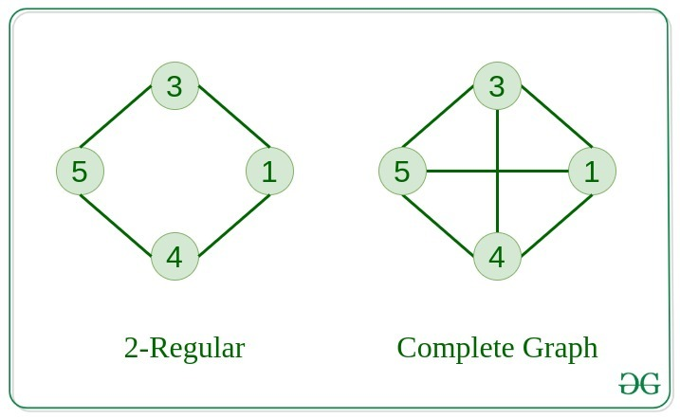
Graph–Types(Cont)
7. Regular Graph
The graph in which the degree of every vertex is equal to K is called K regular graph.
8. Complete Graph
The graph in which from each node there is an edge to each other node.

Slide 9
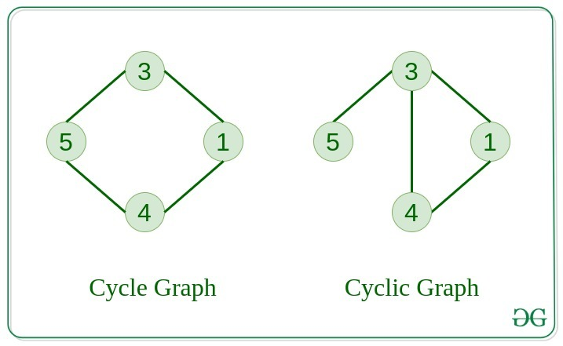
Graph–Types(Cont)
9. Cycle Graph
The graph in which the graph is a cycle in itself, the degree of each vertex is 2.
10. Cyclic Graph
A graph containing at least one cycle is known as a Cyclic graph.

Slide 10
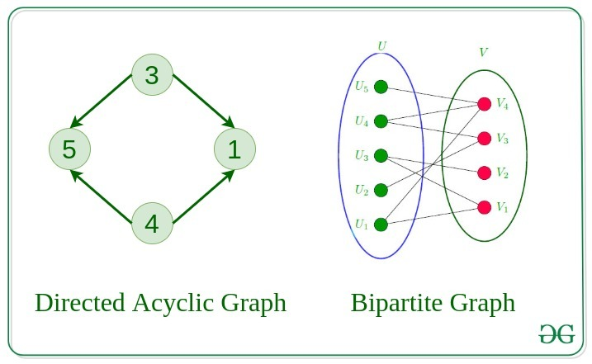
Graph–Types(Cont)
11. Directed Acyclic Graph
A Directed Graph that does not contain any cycle.
12. Bipartite Graph
A graph in which vertex can be divided into two sets such that vertex in each set does not contain any edge between them.

Slide 11
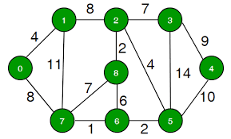
Graph–Types(Cont)
13. Weighted Graph
A graph in which the edges are already specified with suitable weight is known as a weighted graph.
Weighted graphs can be further classified as directed weighted graphs and undirected weighted graphs.

Slide 12
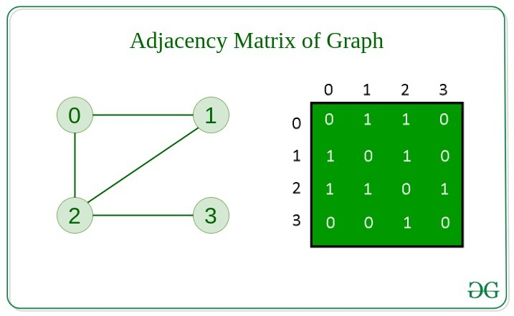
Graphs- Representation
Adjacency Matrix
Graph is stored in the form of the 2D matrix where rows and columns denote vertices.
Each entry in the matrix represents the weight of the edge between those vertices.

Slide 13
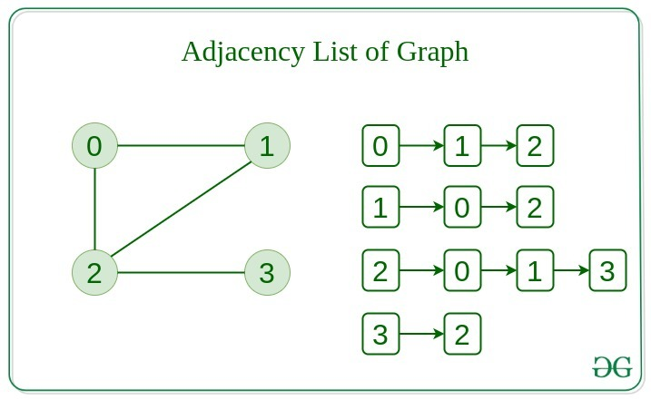
Graphs- Representation
2. Adjacency List
Graph is represented as a collection of linked lists.
There is an array of pointer which points to the edges connected to that vertex.

Slide 14
Graph-Approaches
Graph approaches can be applied in different ways, depending on the problem at hand. Some common graph-based algorithms and techniques include:
Graph traversal algorithms: These algorithms explore a graph by visiting its nodes and edges in a systematic manner, such as breadth-first search (BFS) and depth-first search (DFS).
Shortest path algorithms: These algorithms find the shortest path between two nodes in a graph, such as Dijkstra's algorithm and Floyd-Warshall algorithm.

Slide 15
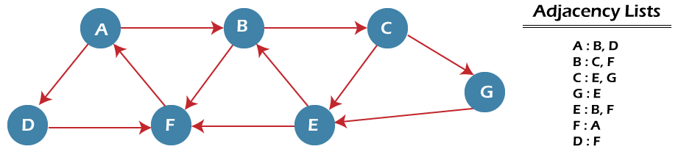
Graph-Approaches(Cont) BFS(Breadth First Search)
Step 1: SET STATUS = 1 (ready state) for each node in G
Step 2: Enqueue the starting node A and set its STATUS = 2 (waiting state)
Step 3: Repeat Steps 4 and 5 until QUEUE is empty
Step 4: Dequeue a node N. Process it and set its STATUS = 3 (processed state).
Step 5: Enqueue all the neighbours of N that are in the ready state (whose STATUS = 1) and set
their STATUS = 2
(waiting state)
[END OF LOOP]
Step 6: EXIT

Slide 16
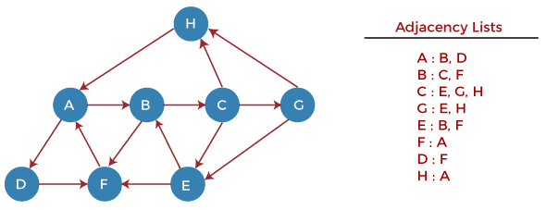
Graph-Approaches(Cont) DFS(Depth First Search)
Step 1: SET STATUS = 1 (ready state) for each node in G
Step 2: Push the starting node A on the stack and set its STATUS = 2 (waiting state)
Step 3: Repeat Steps 4 and 5 until STACK is empty
Step 4: Pop the top node N. Process it and set its STATUS = 3 (processed state)
Step 5: Push on the stack all the neighbors of N that are in the ready state (whose STATUS = 1) and set their STATUS = 2 (waiting state)
[END OF LOOP]
Step 6: EXIT

Slide 17
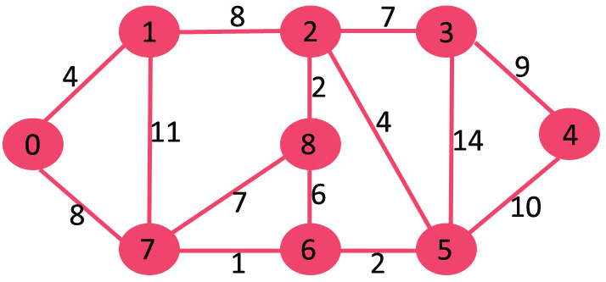
Graph-Approaches(Cont) Dijkstra's algorithm
Step 1:Assign infinite distances to all nodes except the starting node which gets a distance of 0.
Step 2:Choose the node with the smallest distance and visit it.
Step 3:Update the distances of all the neighboring nodes by adding the weight of the edge to the smallest distance.
Step 4:Repeat step 2 and 3 until all nodes have been visited or the smallest tentative distance among the unvisited nodes is infinity.

Slide 18
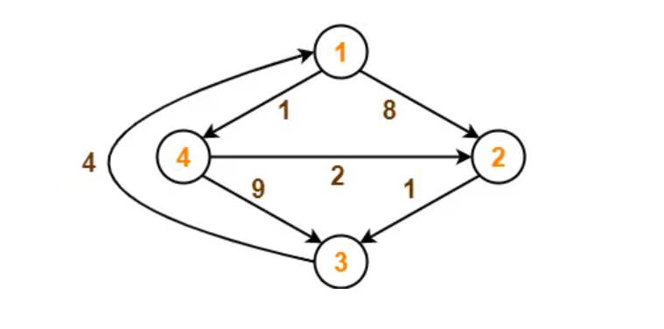
Graph-Approaches(Cont) Floyd-Warshall algorithm
Initialize a matrix of size n x n, where n is the number of nodes in the graph. The matrix is used to store the distances between all pairs of nodes.
Initialize the matrix such that the distance between every node i and j is either the weight of the edge (i, j) if it exists, or infinity if it does not.
For each node k from 1 to n, calculate the distance between all pairs of nodes (i, j) passing through k. If the distance from i to k plus the distance from k to j is less than the current distance from i to j, update the distance.
After the above calculation, the matrix will contain the shortest distance between all pairs of nodes in the graph.

Slide 19
Graph-Approaches(Cont)
Clustering algorithms: These algorithms group nodes in a graph based on their similarity or proximity, such as k-means clustering and spectral clustering.
Centrality measures: These measures identify important nodes or vertices in a graph, such as degree centrality, betweenness centrality, and closeness centrality, which can be used for identifying influential individuals in a social network or critical nodes in a transportation network.
Graph-based machine learning algorithms: These algorithms utilize graph structures to model and learn from data, such as graph neural networks (GNNs) and random walk-based methods.

Slide 20
Graph-Approaches(Cont)
Network flow algorithms: These algorithms model the flow of resources or information in a network, such as the max-flow min-cut theorem and Ford-Fulkerson algorithm.
Graph-based data visualization: These techniques use graphs to visually represent data, such as node-link diagrams, matrix representations, and force-directed layouts, which can be used for visualizing complex relationships in data.

Slide 21
Graph-Case Study
Here is real-time example of how graph is used:
Social Networks: Social networks such as Facebook, LinkedIn, and Twitter utilize graphs to represent relationships between users.
Each user can be represented as a node, and the friendships or connections between users can be represented as edges in an undirected graph.
This allows for various graph-based algorithms to be applied for tasks such as finding friends of friends, recommending connections, or identifying communities within the network.

Slide 22
Graph-Benefits
Graphs have several benefits that make them suitable for various applications:
Representation of complex relationships:
Graphs are a flexible data structure that can represent complex relationships between entities.
Efficient data retrieval and traversal:
Graphs allow for efficient data retrieval and traversal operations.

Slide 23
Graph-Benefits(Cont)
Flexibility and extensibility:
Graphs are flexible and extensible, allowing for easy addition, deletion, or modification of nodes and edges.
Scalability and performance:
Graph databases and graph-based algorithms are designed for handling large-scale data and can scale horizontally to accommodate growing data volumes.

Slide 24
THANK YOU

